Slide 1
Code Smells
And
Refactoring

Slide 2
Why do good developers write bad software?
* Requirements change over time, making it hard to update your code (leading to less optimal designs)
* Time and money cause you to take shortcuts
* You learn a better way to do something (the second time you paint a room, it’s always better than the first because you learned during the first time!)

Slide 3
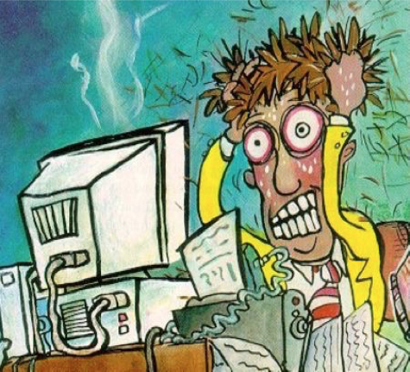
The Problem...

Slide 4
Why should you Refactor
* Makes software easier to understand
* Improves design of existing software
* Helps you finds bugs
* Helps you program faster

Slide 5
When should you Refactor
* Refactoring is something you should do all the time in little bursts.
* It’s always BEST to:
** Refactor when you add functionality.
** Refactor when you need to fix a bug.
** Refactor when you are performing code review.

Slide 6
Two Hat Principle
* Wear one hat a time
* When you add functionality, you shouldn't be changing existing code
* When you Refactor, you make a point of not adding functionality
* Swap hats frequently whenever required

Slide 7
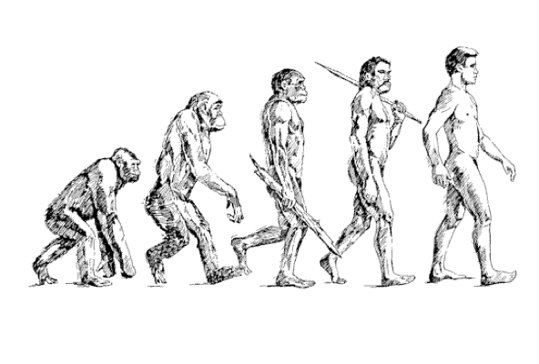
Code Refactoring ...

Slide 8
Refactoring
Definition: Refactoring modifies software to improve its readability, maintainability, and extensibility without changing what it actually does.
External behavior does NOT change
Internal structure is improved

Slide 9
Danger !!!
* Refactoring CAN introduce problems, because anytime you modify software you may introduce bugs
* Refactoring adds risk
* It’s expensive – we’re spending time in development, but not “seeing” any external differences
* And we still have to retest
Why are we doing this?

Slide 10
Motivation
We refactor because we understand getting the design right the first time is hard and you get many benefits from refactoring:
* Code size is often reduced
* Confusing code is restructured into simpler code
* Both of these greatly improve maintainability! Which is required because requirements always change!
* Increase readability and understandability
* Reduce debugging time

Slide 11
Bad Smells in Code
* Duplicate Code
* Long Method
* Large Class
* Lazy Class
* Switch Statements
* Long Parameter List
* Shotgun Surgery
* Feature Envy
* Improper Naming

Slide 12
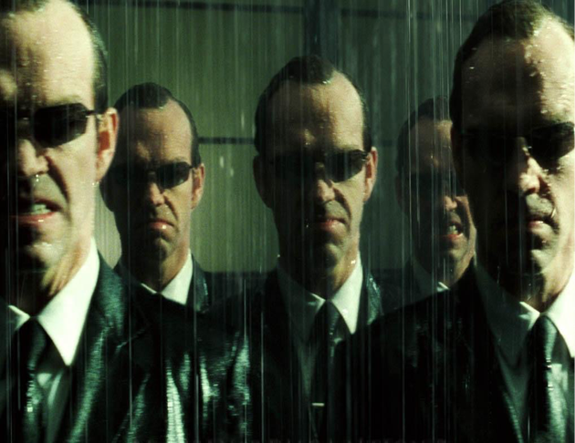
Duplicate Code

Slide 13
Q. Why duplicate code is a bad smell ?
* To do a single change you might require to do at multiple locations.
* You have to remember to fix a bug at more than one location. What if you forget some location?
* Increases the code size. Hence, harder to read and creates confusion, and harder to debug, in short harder to maintain.

Slide 14
Treatment
If the same code is found in two or more methods in the same class: use Extract Method and place calls for the new method in both places.
If the same code is found in two subclasses of the same level: Use Extract Method for both classes, followed by Pull Up Field for the fields used in the method that you are pulling up.
If duplicate code is found in two different classes: If the classes are not part of a hierarchy, use Extract Superclass in order to create a single superclass for these classes that maintains all the previous functionality.
If the same code is performed in all branches of a conditional expression: place the identical code outside of the condition tree by using Consolidate Duplicate Conditional Fragments.

Slide 15

Long Method
Why long method is a bad smell ?
Difficult to understand in one go.
Almost impossible to re-use, hence gives rise to duplicate copy/paste code.
Difficult to over-ride
Non-cohesive.

Slide 16
Treatment
To reduce the length of a method body, use Extract Method.
If local variables and parameters interfere with extracting a method, use Replace Temp with Query or Preserve Whole Object.
Conditional operators and loops are a good clue that code can be moved to a separate method. For conditionals, use Decompose Conditional. If loops are in the way, try Extract Method.

Slide 17
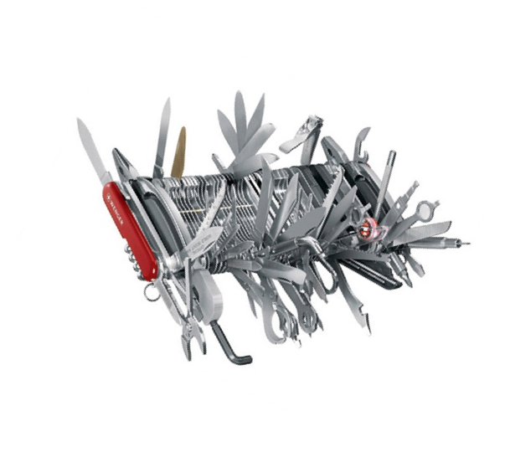
Large Class
Large classes, like long methods, are difficult to read, understand, and troubleshoot.
Does the class contain too many responsibilities?
Can the large class be restructured or broken into smaller classes?

Slide 18
Treatment
Payoff
Extract Class helps if part of the behavior of the large class can be spun off into a separate component.
Extract Subclass helps if part of the behavior of the large class can be implemented in different ways or is used in rare cases.
Refactoring of these classes spares developers from needing to remember a large number of attributes for a class.
In many cases, splitting large classes into parts avoids duplication of code and functionality.

Slide 19
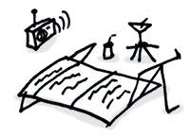
Lazy Class
Understanding and maintaining classes always costs time and money. So if a class doesn't do enough to earn your attention, it should be deleted.
Reasons for the Problem
Perhaps a class was designed to be fully functional but after some of the refactoring it has become ridiculously small.
Or perhaps it was designed to support future development work that never got done.

Slide 20
Treatment
Payoff
Components that are near-useless should be given the Inline Class treatment.
For subclasses with few functions, try Collapse Hierarchy.
Reduced code size.
Easier maintenance.

Slide 21
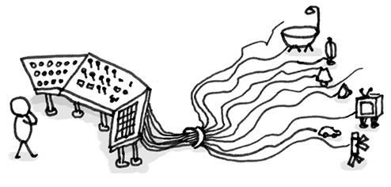
Switch Statements
You have a complex switch operator or a sequence of if statements.

Slide 22
Treatment
To isolate switch and put it in the right class, you may need Extract Method and then Move Method.
If a switch is based on type code, such as when the program's runtime mode is switched, use Replace Type Code with Subclasses.
After specifying the inheritance structure, use Replace Conditional with Polymorphism.

Slide 23
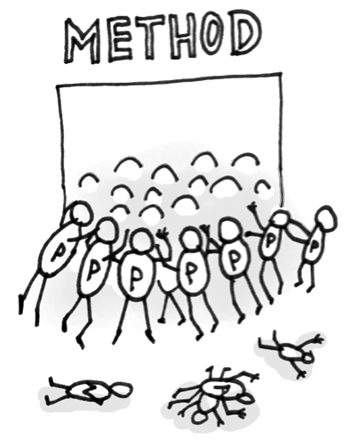
Long Parameter List
More than three or four parameters for a method.

Slide 24
Treatment
Check what values are passed to parameters. If some of the arguments are just results of method calls of another object, use Replace Parameter with Method Call.
Instead of passing a group of data received from another object as parameters, pass the object itself to the method, by using Preserve Whole Object.
If there are several unrelated data elements, sometimes you can merge them into a single parameter object via Introduce Parameter Object.

Slide 25
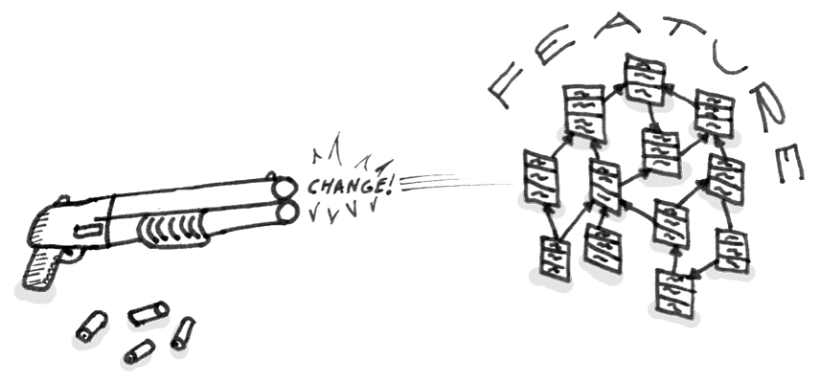
Shotgun Surgery
Making any modifications requires that you make many small changes to many different classes.
This happens when a single responsibility has been split up among a large number of classes.

Slide 26
Treatment
Use Move Method and Move Field to move existing class behaviors into a single class. If there is no class appropriate for this, create a new one.
If moving code to the same class leaves the original classes almost empty, try to get rid of these now-redundant classes via Inline Class.

Slide 27

Feature Envy
A method accesses the data of another object more than its own data.
If a method clearly should be moved to another place, use Move Method.
If only part of a method accesses the data of another object, use Extract Method to move the part in question.

Slide 28

Improper Naming
Does the name of the method succinctly describe what that method does? Could you read the method's name to another developer and have them explain to you what it does? If not, rename it or rewrite it.

Slide 29
Other Code Smells
Inconsistent Names
Pick a set of standard terminology and stick to it throughout your methods. For example, if you have Open(), you should probably have Close().
Dead Code
Ruthlessly delete code that isn't being used. That's why we have source control systems!

Slide 30
Data Clumps
If you always see the same data hanging around together, maybe it belongs together. Consider rolling the related data up into a larger class.
Indecent Exposure
Beware of classes that unnecessarily expose their internals. Aggressively refactor classes to minimize their public surface. You should have a compelling reason for every item you make public. If you don't, hide it.

Slide 31
Conclusion
Refactoring is the most satisfying and gratifying experience. Ask someone who has done it :)‏
Refactoring also comes with HUGE rewards. ( It will count in your next appraisal cycle. ;)‏
So, Refactor Actively and Continuously.

Slide 32
Famous saying:
“I am not a great programmer, I am just a good programmer with great habits”
THANK YOU !!

Slide 33
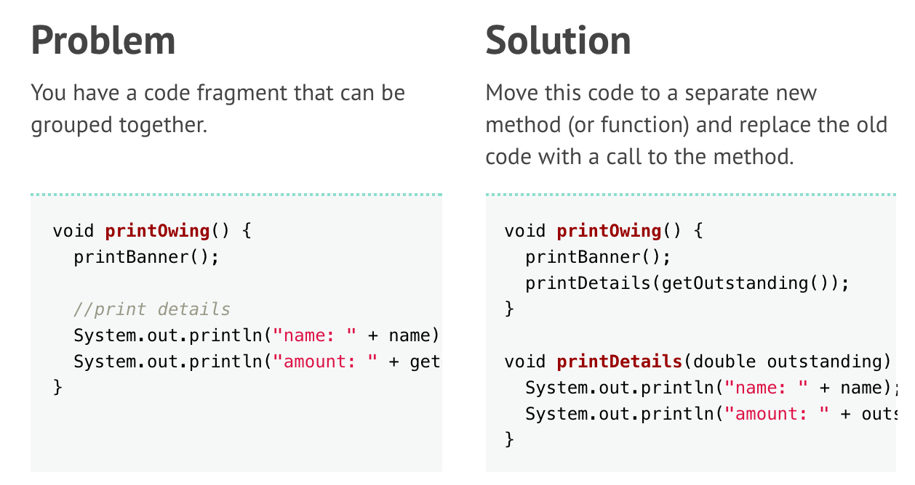
Extract Method
Duplicate Code
Long Method
Feature Envy
Switch Statements

Slide 34
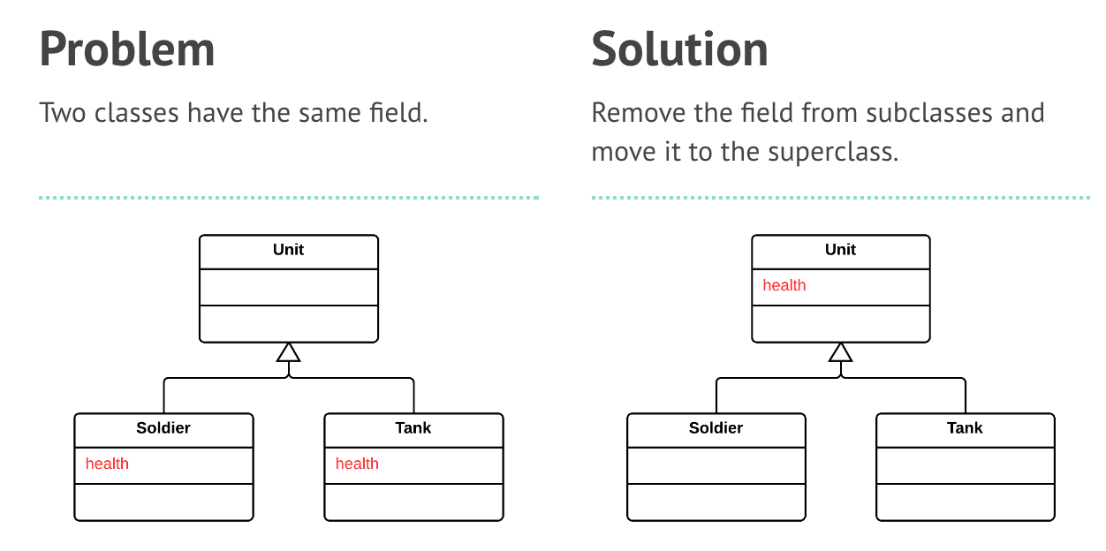
Pull Up Field
Duplicate Code

Slide 35
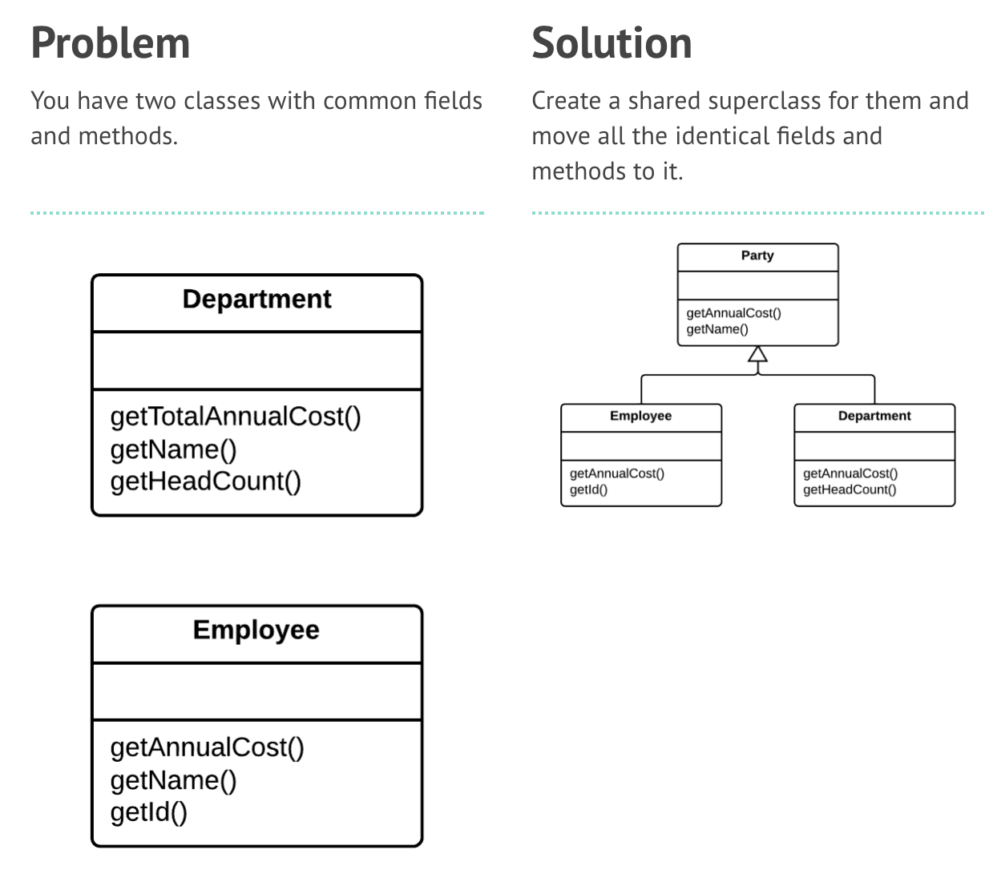
Extract Superclass
Duplicate Code

Slide 36
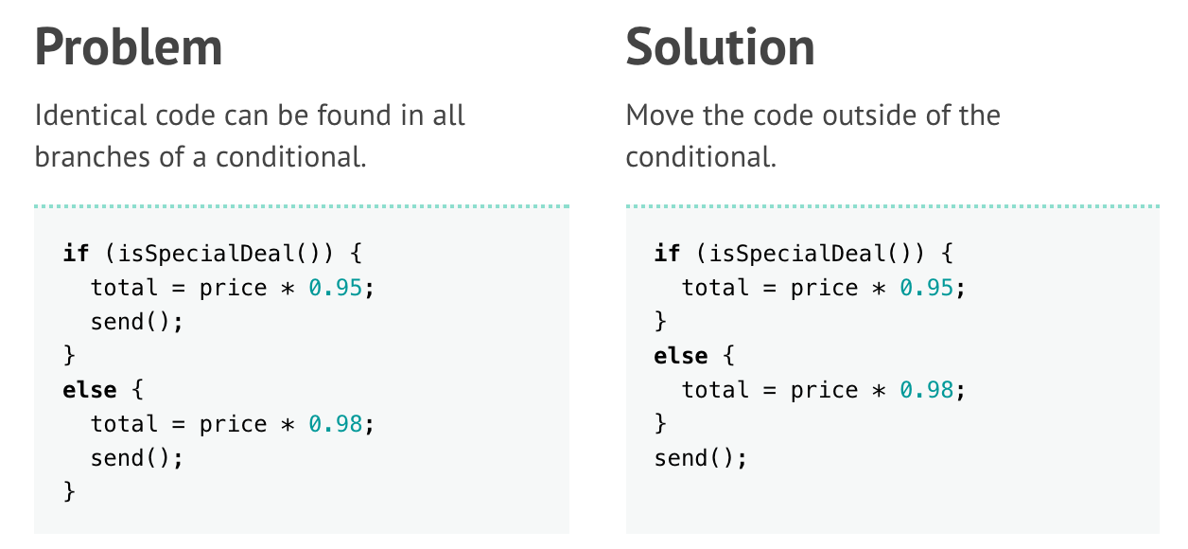
Consolidate Duplicate Conditional Fragments
Duplicate Code

Slide 37
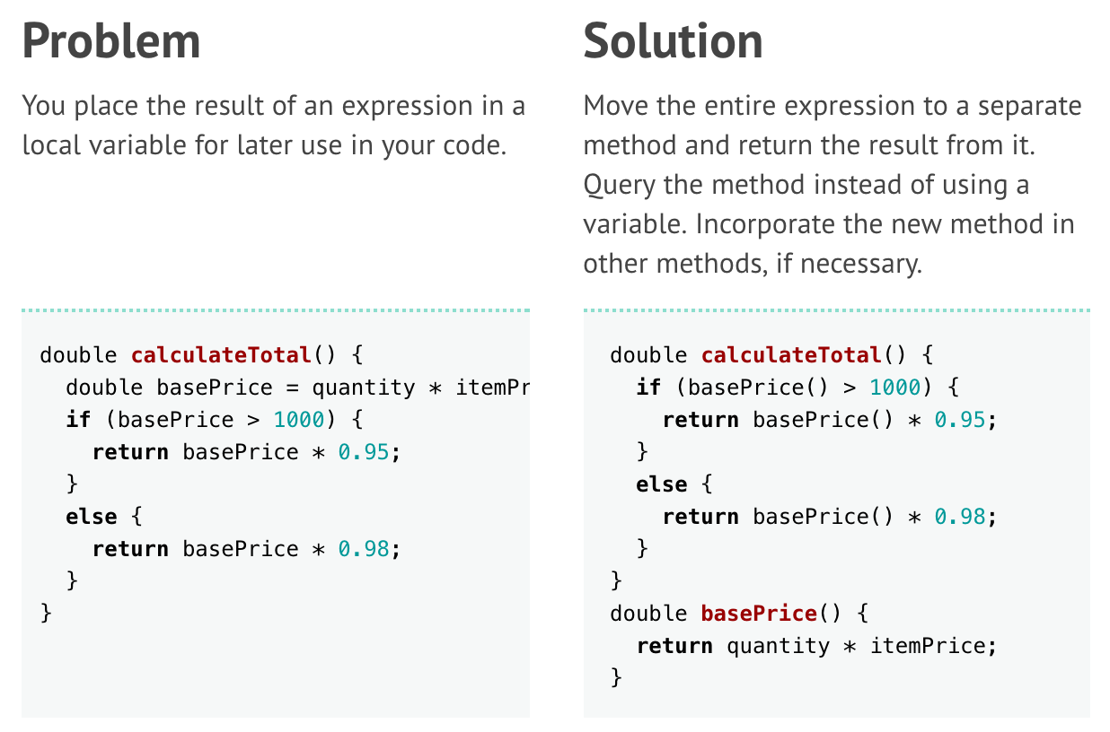
Replace Temp with Query
Long Method

Slide 38
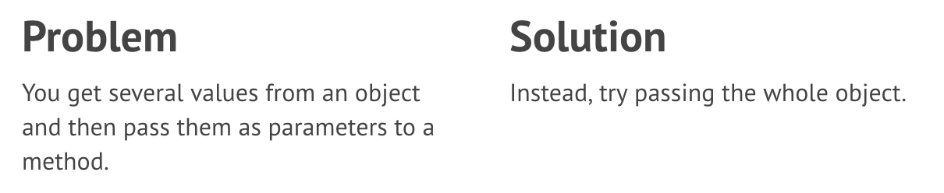
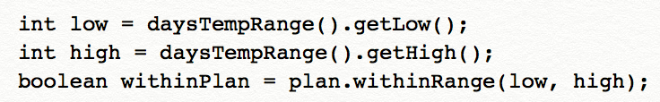
Preserve Whole Object
Long Method
Long Parameter List

Slide 39
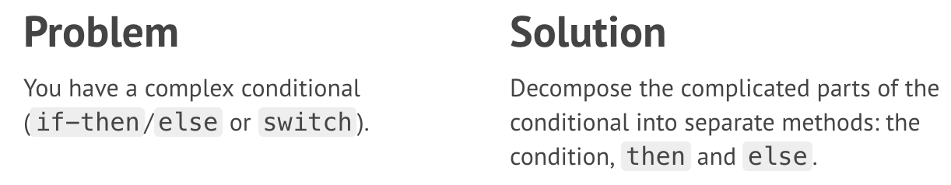
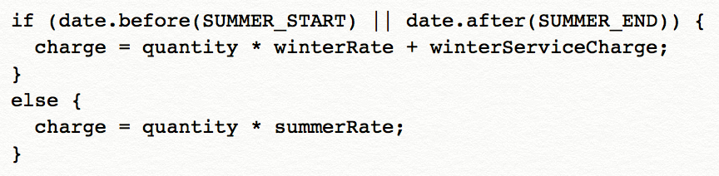
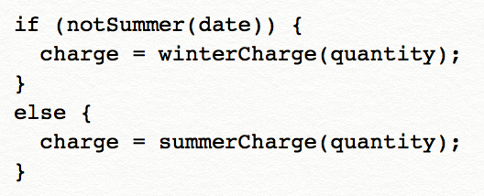
Decompose Conditional
Long Method

Slide 40
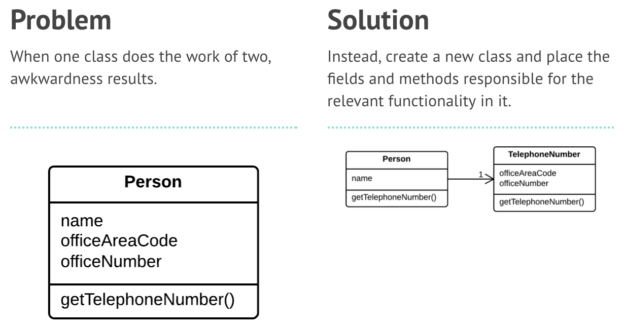
Extract Class
Large Class

Slide 41
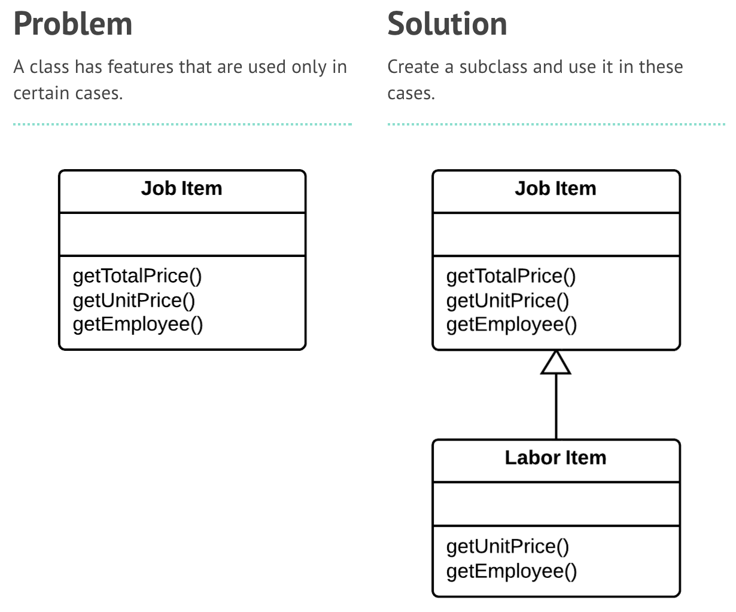
Extract Subclass
Large Class

Slide 42
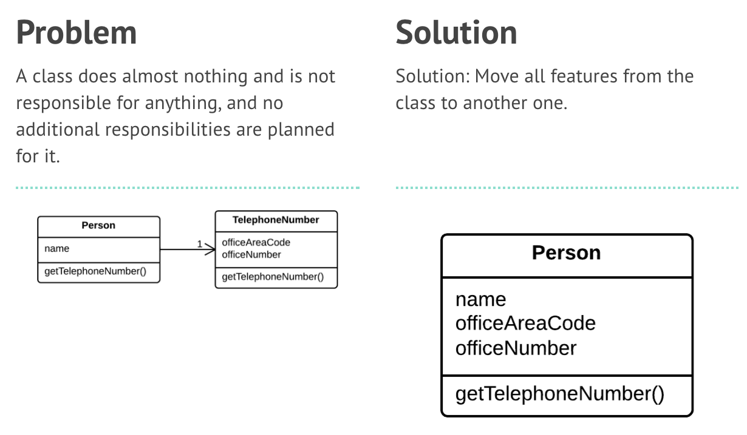
Inline Class
Lazy Class
Shotgun Surgery

Slide 43
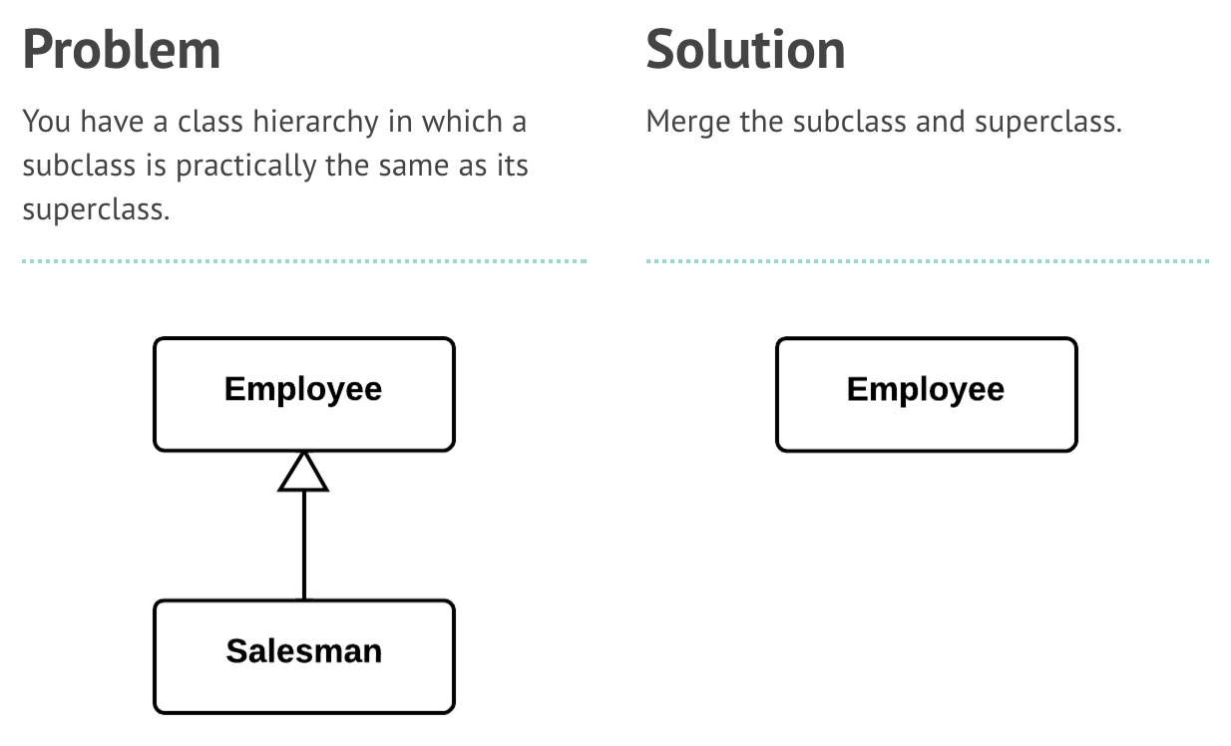
Collapse Hierarchy
Lazy Class

Slide 44
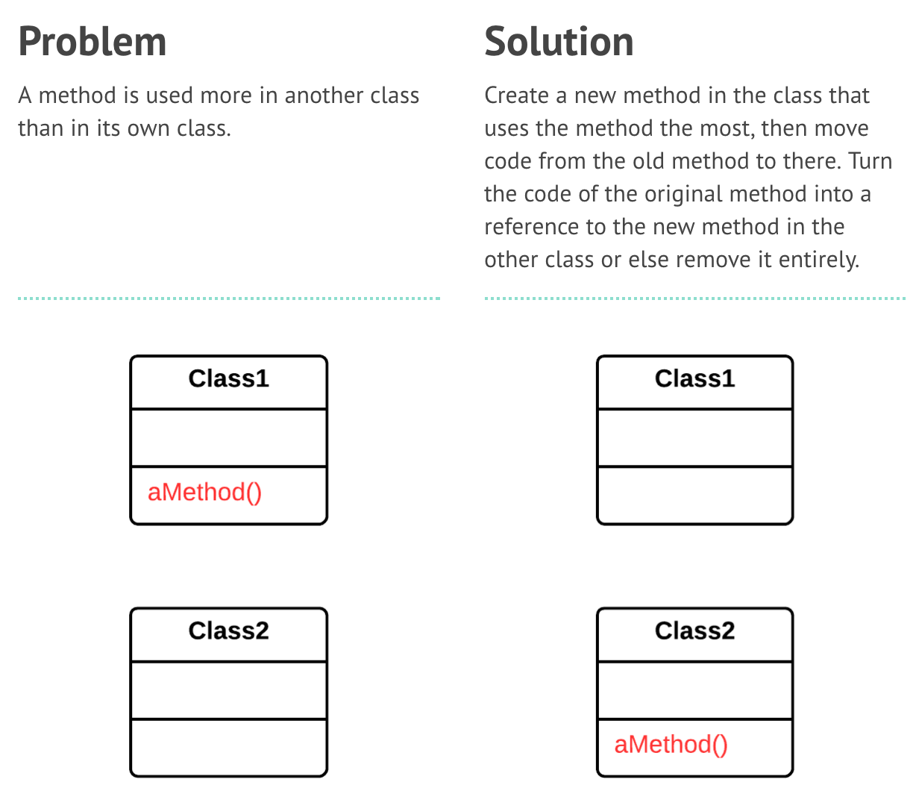
Move Method
Feature Envy
Switch Statements
Shotgun Surgery

Slide 45
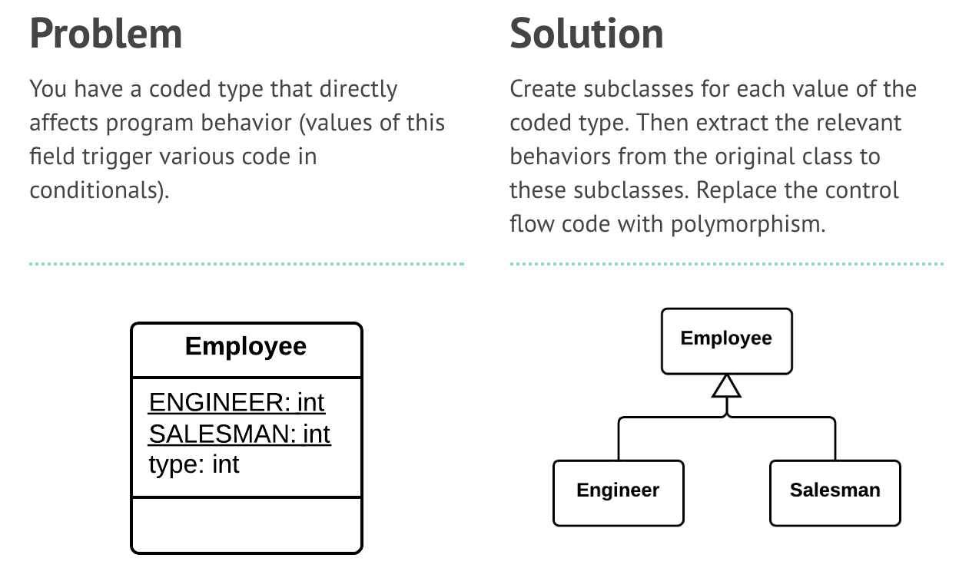
Replace Type Code with Subclasses
Switch Statements

Slide 46
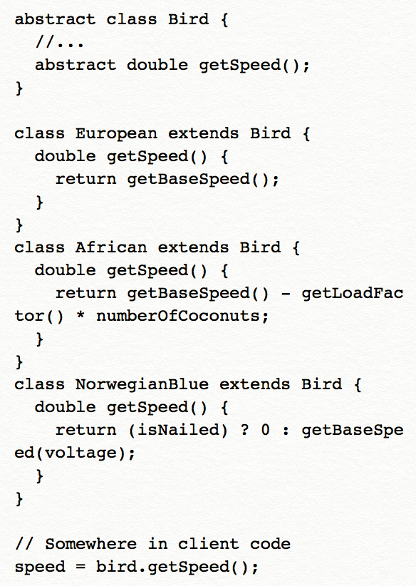
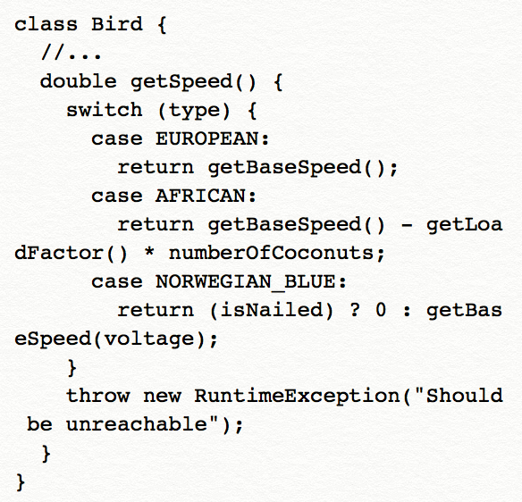
Replace Conditional with Polymorphism
Switch Statements

Slide 47
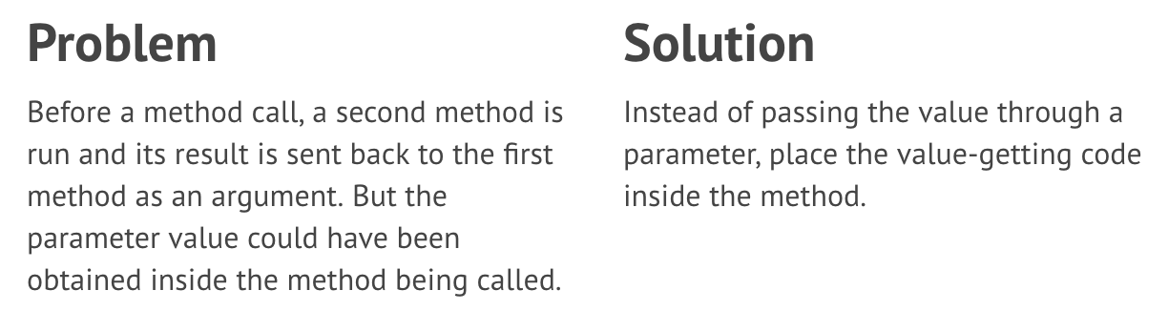
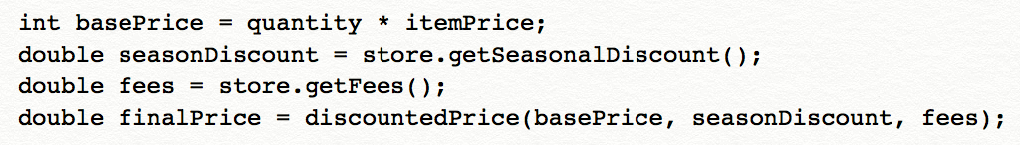
Replace Parameter with Method Call
Long Parameter List

Slide 48
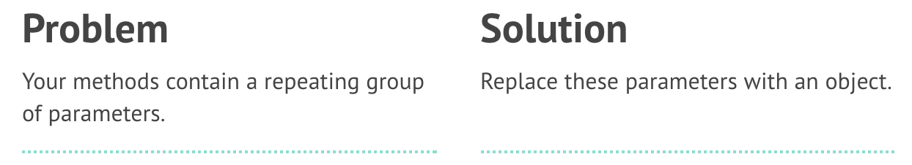
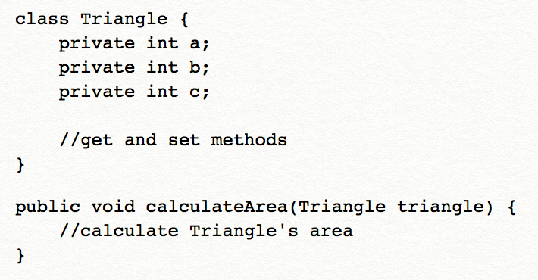
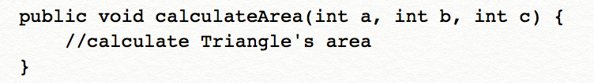
Introduce Parameter Object
Long Parameter List

Slide 49
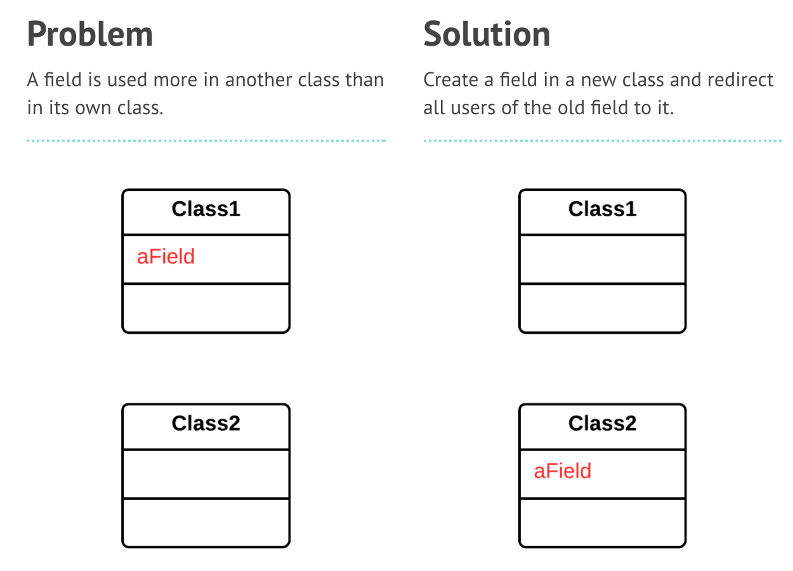
Move Field
Shotgun Surgery

